Slide 1

ISO 27001
IT20620066
Weththasinghe M N G

Slide 2

Content
Overview
ISO 27001
Information Security Management System
ISO 27001 Implement Guide
Benefits of ISO 27001 Certification
Toolkit Documents explaining the standards
ISO 27001 Advantages and Disadvantages

Slide 3
Overview
A rule, principle, technique, procedure, or template is referred to as an IT Standard if it is intended to bring consistency to the planning, creation, management, and governance of information technology services. An ISO standard is a set of procedures that are agreed upon by many different countries. This way, everyone is following the same rules, which leads to a safer and more predictable outcome. Organizations with ISO 27001 certification can demonstrate to clients, partners, and investors that they have taken precautions to protect data in the case of a breach.

Slide 4
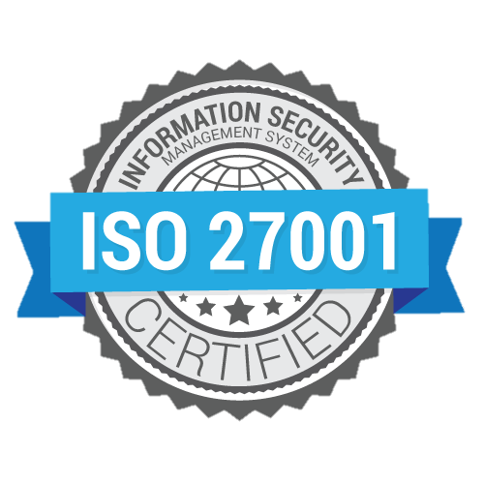
ISO 27001
The ISO 27001 specification for an information security management system, formerly known as ISO/IEC 27001:2013 (ISMS). An organization's information risk management procedures are governed by an ISMS, which is a set of policies and guidelines that also covers all physical, technical, and legal controls. It is the international standard for information security. It sets out the specification for an information security management system (ISMS). ISO 27001's best-practice approach helps organizations manage their information security by addressing people, processes, and technology.

Slide 5
Information Security Management System
An information security management system, or ISMS, is a set of guidelines and rules that govern how a business handles sensitive data (ISMS). The international security standard known as ISO 27001 contains implementation guidelines for ISMS requirements.
Two excellent resources to get began with implementing an ISMS are ISO 27001 and the best-practice guidelines or procedures found in ISO 27002.
The strength of the security risk assessment is essential for an organization's implementation of an ISM
IT Policies
IT Security
Security
Processes
Activities

Slide 6
ISO 27001 Implement Guide
Step 1: Assemble an implementation team
Step 2: Develop the implementation plan
Step 3: Initiate the ISMS
Step 4: Define the ISMS scope
Step 5: Identify your security baseline
Step 6: Establish a risk management process
Step 7: Implement a risk treatment plan
Step 8: Measure, monitor, and review
Step 9: Certify your ISMS

Slide 7
Benefits of ISO 27001 certification
Control of IT Risk
Reduce Security breaches
Maintain the confidentiality of information
Minimize IT Risks, damage, and subsequent costs
Competitive edge due to globally recognized statured
Structured method to address security requirements
Fulfilment of globally recognized security requirements
Systematic detection of vulnerabilities
Increase in trust

Slide 8
Toolkit documents explaining the Standards
ISO 27000 ISMS Organization chart data
ISO 27000 Model policy on change Management and Control
ISO 27000 SOA 2013
ISO 27000 ISMS Internal audit procedure
Data Restoration Form
Nonconformity corrective preventive action form
Business case
Information classification matrix
Asset Register

Slide 9
Toolkit documents explaining the Standards
ISO27001 Implementation Guideline
Asset Inventory
ISO 27001 Road map
Information Security Policy
ISO 27001 Roles and Responsibilities
Acceptable use policy
Access control policy
Risk Register
Risk Treatment Plan

Slide 10
ISO 27001 Advantages and Disadvantages
Advantage
Improved competitive advantages.
Losses due to security incidents are reduced.
Fines are reduced as a result of contractual or legal non-compliance.
Internal organizational development.
ISO 27001 will protect your organization from cybercrime.
Disadvantage
In personal opposition, Some people may consider it a waste of resources throughout the implementation and maintenance phase.

Slide 11
Thank you

